Slide 1


Major Rivers in North America
HandHands on Lesson 5

Slide 2
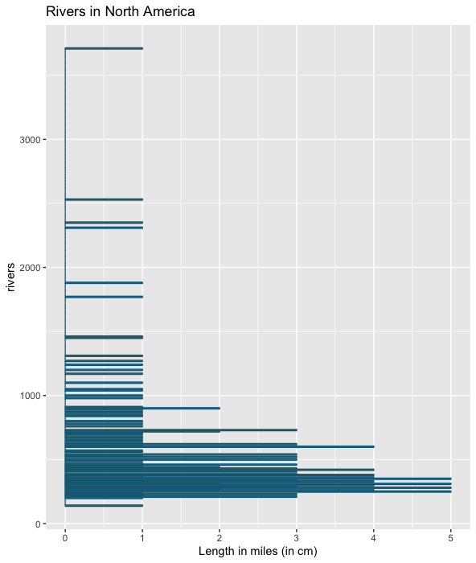
Histogram
Of
Rivers
suitable bin widths

Slide 4
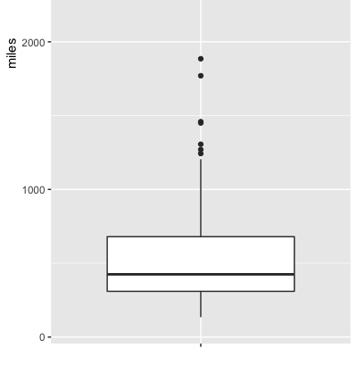
Box Plot

Slide 5
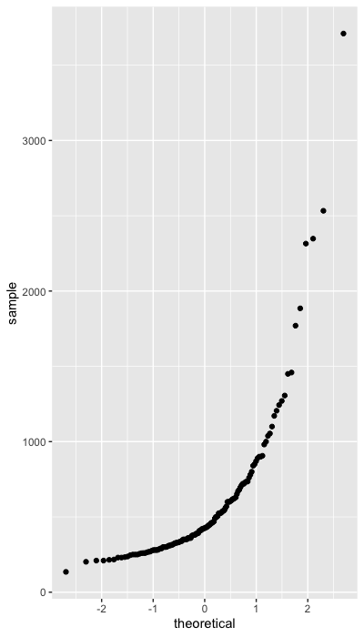
Normal
Probability
Plot

Slide 6
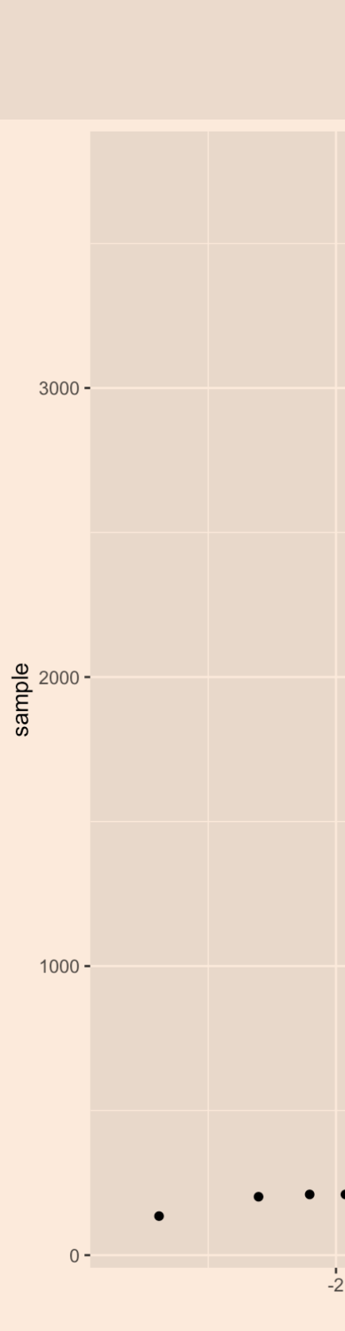
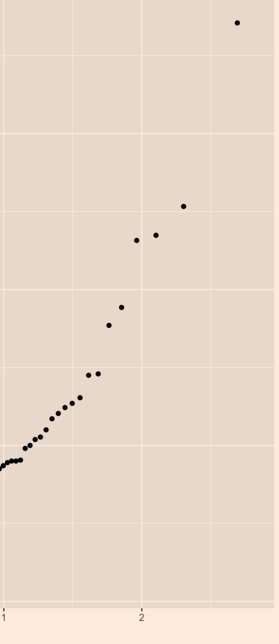
Are there any outliers in this Data set ?
Yes have outliers

Slide 7
Are there high or low outliers?
Yes have both.

Slide 8
Do these data appear to come from a normal distribution ?
So this indicates that these data have a distribution that is approximately normal.

